Slide 1
Simple Hiring Project
- Manasvi Sharma

Slide 2
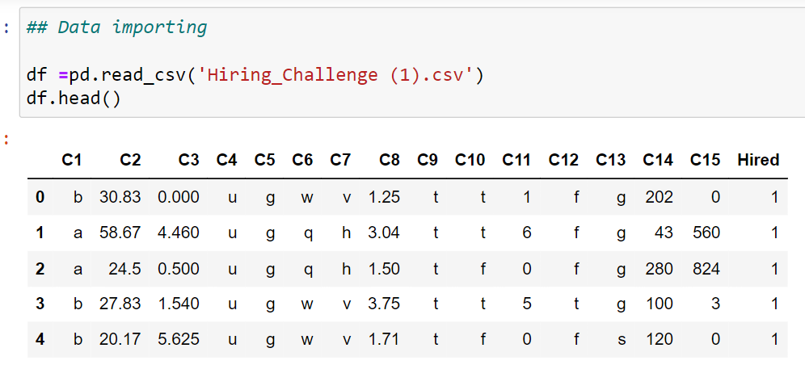
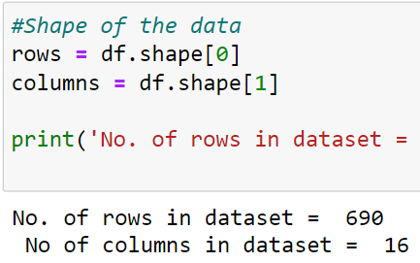
Dataset and problem Statement
Problem Statement :- In this problem statement we have to predict wether a candidate is likely to get hired or not
Dataset:- Dataset is having 690 datapoints and 16 columns (including Output column named as Hired)
Fig1: shows first 5 rows of dataset
Fig2: shows no. of total rows and columns present in dataset

Slide 3
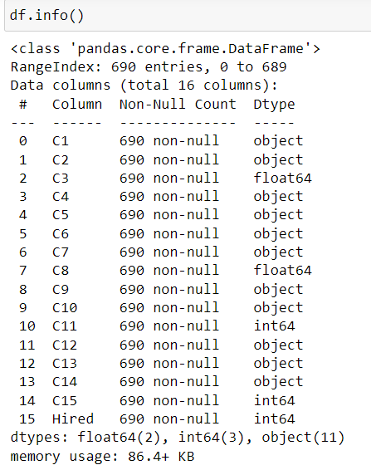
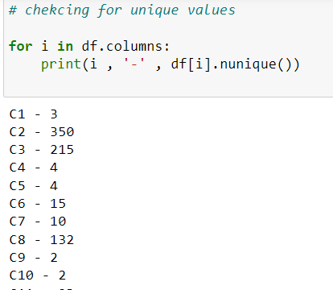
General Methodology
Step 1 : Data Understanding
Step 2 : Data Cleaning / preprocessing
Step 3 : scaling the data if required
Step 4 : Train test split
Step 5 : Model Building
Step 6 : Evaluate the model
Step 1 : Data Understanding
Here we have total 16 columns (15 Independent features and 1 dependent feature )
Initially we have three types of datatypes – (int , float and object , we can change the datatype as and when required as we going further )
When checked with df.nunique() , we can clearly see there are several number of columns are categorical in nature.

Slide 4
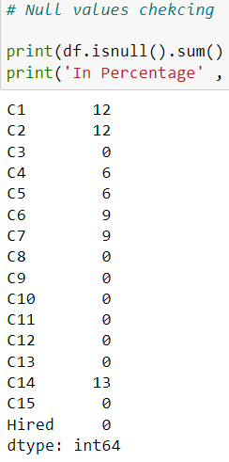
Continue…
Step 2 : Data Cleaning/preprocessing
Checking for null values:
we found out some null values in dataset , and due to the percentage for null values lies between 1-2 percentage for whole dataset , decided to drop out them.
After dropping the null values we have left 653 datapoints or rows and 16 columns in dataset.
Channing the datatype:-
As we have seen earlier we have some datatype which are categorical in nature so we have done conversion using Label Encoder .

Slide 5
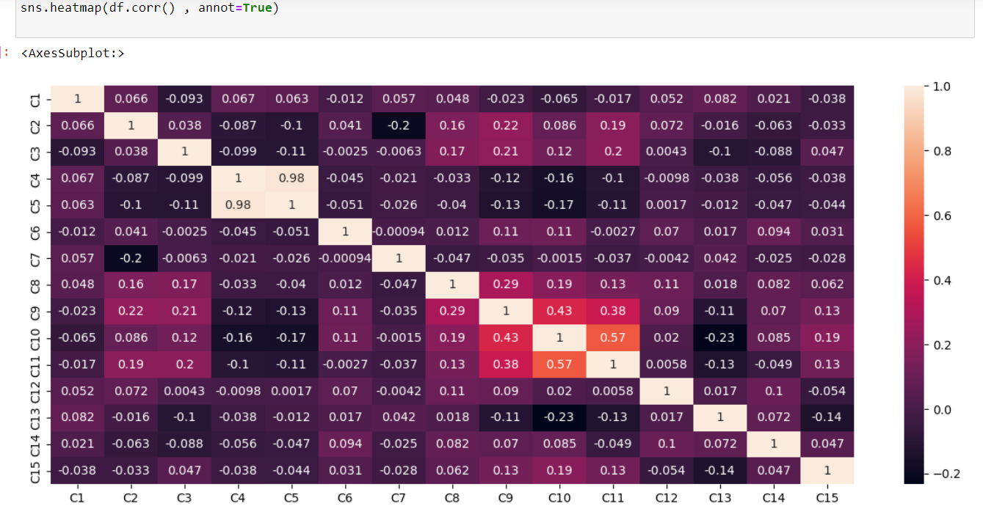
Checking for outliers
Used IQR method to detect the outlier and got some values.
Decided to replace with median because we have a dataset which is robust to outliers so for filling the outliers datapoint with median as median is not robust to outliers.
Checking for highly correlated columns :
we have found out that ‘C5’ variable is having the highest correlation with independent variable(this can impact the model)
Decided to drop out the c5 feature.

Slide 6
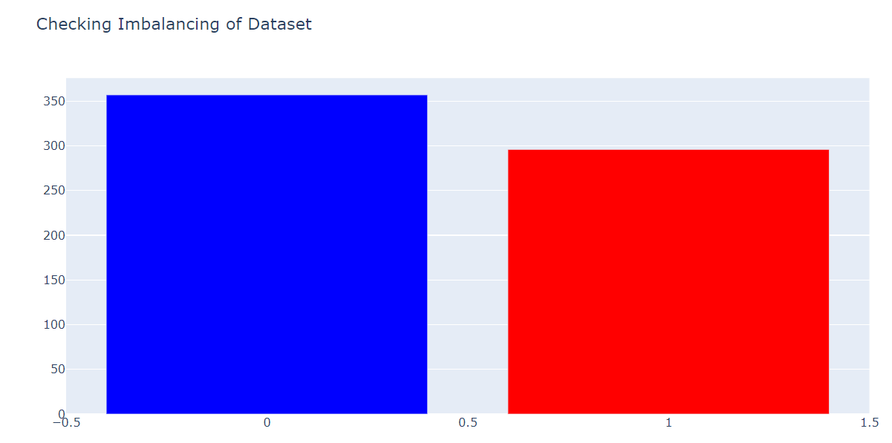
Checking for imbalanced data
When checked for imbalanced data,it is found that the data is balanced no major difference can be seen.
Hence no need to apply any sampling technique

Slide 7
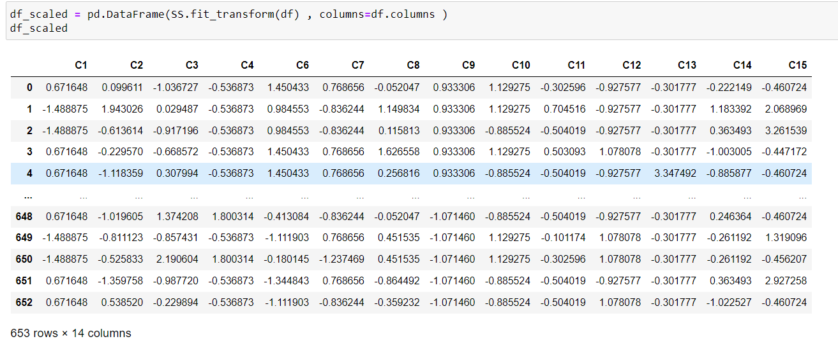
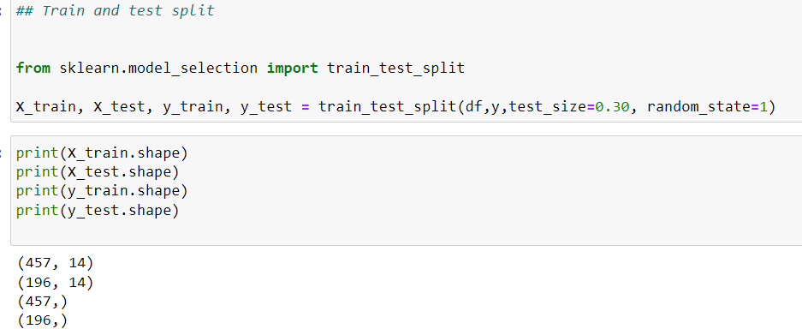
Step 3: Scaling the data
As we have seen some variables are having huge numbers and some of them having very small number , in order to balance them out we have to scale the data , hence done scaling.
Step 4 : Train test split
We have done the train and test split.
The ratio of train and test split is 70:30 , with random state =1

Slide 8
Step 5: Model Building :
As we have categorical type output feature , so we are dealing with classifications problem. For classification we have Logistic Regression classifier , Decision Tree Classifier , Random forest , SVM , KNN , Naïve Bayes classifier etc.
So I’ve decided to go ahead with one by one and then grid search CV
Step 6 : Evaluate the Model :
For Evaluation we have decide to go with Accuracy ( Metrics like accuracy , precision , recall are good ways to evaluate when we have balanced dataset)
One by one we have checked all the model’s accuracy (for training as well as testing dataset)
Some of model were overfitting while some of them were under performing.
At last we have got the best model that is Naïve Bayes Algo.
Naïve bayes algo accuracy was 0.872 with test dataset. So we are predicting all our further datapoints with this only.

Slide 9
Thank you

